Slide 1

Gestational Diabetes
Tauni Rowberry RN, FNP-C

Slide 2
What is Gestational Diabetes (GDM)?
Any degree of glucose intolerance with onset or first recognition during pregnancy
Insulin resistance is a characteristic of all pregnancies, presumably based on the fetal-placental hormone production and release
However, some are unable to sufficiently augment their insulin response, or are more insulin resistant than average, and develop hyperglycemia that is labeled gestastional diabetes
American Diabetes Association

Slide 3
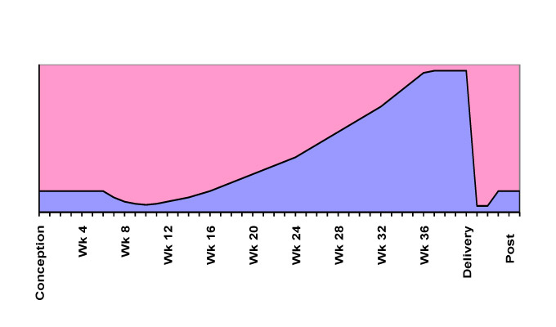
Insulin needs in pregnancy

Slide 4

Insulin is the key to allow sugar through the door into the cell
The cell needs the sugar for energy
Sugar travels in the blood

Slide 5
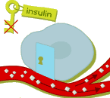
Insulin is the key to allow sugar through the door into the cell
The cell needs the sugar for energy
The key can’t open the door
Sugar travels in the blood.
(Now increased due to the insulin resistance)

Slide 6
Risk Factors for GDM
Obesity
History of GDM
Strong family history of diabetes
History of Insulin Resistance

Slide 7

GDM and You
Polyhydramnios
  Increased fluid around baby
Risk for infection
  Bladder, kidney, and vaginal
Hypertensive blood pressure disorders
  Pre-eclampsia more common
Increased chance of C-Section
  Due to large baby

Slide 8
Possible complications of GDM
Macrosomia (Large Baby)
  Baby with increased weight at shoulders and abdomen
  Birth injury (Shoulder dystocia)
Preterm birth
Neonatal hypoglycemia
  Baby keeps making extra insulin due to mom’s high blood sugars during pregnancy, which after birth can cause a low blood sugar
Respiratory Distress
  Delay in lung maturity
Jaundice
  Yellowing of the skin/eyes if the liver is affected
Stillbirth due to consistent high blood sugars

Slide 9
Treatment of GDM and prevention of problems
Good control of your blood sugars
Medical Nutrition Therapy
Exercise
Medication Therapy
  Oral treatment
  Insulin

Slide 10

Blood sugar monitoring
Blood sugar will be tested at least 4 times per day
  Fasting (when you wake up or 8 hrs since last meal)
  1 hour after breakfast
  1 hour after lunch
  1 hour after dinner
Target Levels
  Fasting: less than 95 mg/dl
  1 hour: less than 130-140
  2 hour: less than 120

Slide 11
TIPS
If Blood Glucose less than <70
-Take 15-20 gm sugar (4oz juice/soda, 8oz milk, 1T honey)
-Wait 15 min and recheck blood sugar, if still low, repeat
-Once returns to normal range, eat snack or meal
-When you’ve used these steps, call office
Goal Ranges:
  Fasting: 70-90
  Meals: 1 Hour< 130 2 hour <120
A lot of learning is involved, please call if you have any questions or concerns.

Slide 12
Logging and reporting
You will log your blood sugars and turn in your log weekly (patient portal preferred)
Please put notes for any reason you think a blood sugar may have been out of normal range
Please use the patient portal to import your numbers weekly (other option fax)
Bring your paper log to your appointments

Slide 14
Factors that Affect Blood Glucose
Stress
Time of Day
  High blood glucose levels after breakfast common in GDM
Exercise
  Decreases sugar levels
Carbohydrate intake

Slide 15
Medical Nutrition Therapy
Eat 3 small meals per day with 3 snacks
Eat every 2-4 hours
About 1800 cal (may need to be figured specific for you)
Carbohydrates- recommended 175 gm/day in 2nd and 3rd Trimester
Protein at every meal and snack
Healthy Fats
Consistency
Drink Water 64-100 oz per day

Slide 16
Carb guidelines +/- 5 grams
Breakfast | Snack | Lunch | Snack | Dinner | Snack
30 | 20 | 50 | 20 | 50 | 20-30

Slide 17

Exercise
Goal 30 minutes daily
  Okay to break down into 10 minutes 3x/day
Avoid contact sports or activities with risk of falling
Many online “at home pregnancy workout” videos
steve cole images/Getty

Slide 18

Medication management
If half of the blood sugars are higher than desired in a determined timed period- you will need medication
Insulin (Preferred) or an Oral
Agent (Metformin)
  Determined by the provider
  Insulin does not cross the
  placenta
  Metformin helps the body utilize
  the existing insulin and is safe in
  pregnancy

Slide 19
Prenatal care
Growth US
  Every 4 weeks until delivery (28, 32, 36)
NST (Non-stress test)
  Monitor connected with a belt that tells the baby’s heart rate
  1-2 times per week determined by provider starting at 36 weeks (32 weeks if on insulin)
AFI (Amniotic Fluid Index)
  Limited US to look at fluid level around baby
  Weekly at 36 weeks (32 weeks if on insulin)
Kick counts daily
Delivery goal about 39-40 weeks

Slide 20
Labor and delivery
Blood sugars will be monitored and managed by L&D nurse under direction of your Provider
Baby’s blood sugar will be checked after delivery to watch for low blood sugar and will be managed by the Pediatrician
After Delivery your blood sugars usually return to normal
Breastfeeding is encouraged due to benefits for mom and baby
  Lower risk of diabetes in mom
  Possible weight loss in mom and decrease chance of obesity in infant through lifetime

Slide 21
Risk and Prevention of diabetes
Your risk of Diabetes is 40-60% after having GDM in your lifetime
At 6-12 weeks after delivery you should have a 75 gm 2 hour GTT (glucose tolerance test)
  Some providers may choose a different testing method
Have testing to rule out diabetes every 1-3 years
Continue healthy eating
Continue exercise

Slide 22
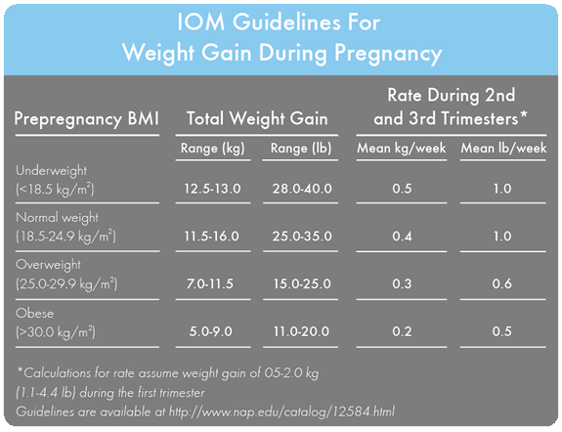
May experience some weight loss with lifestyle changes then weight should stabilize

Slide 23
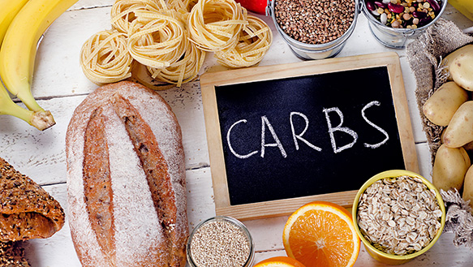
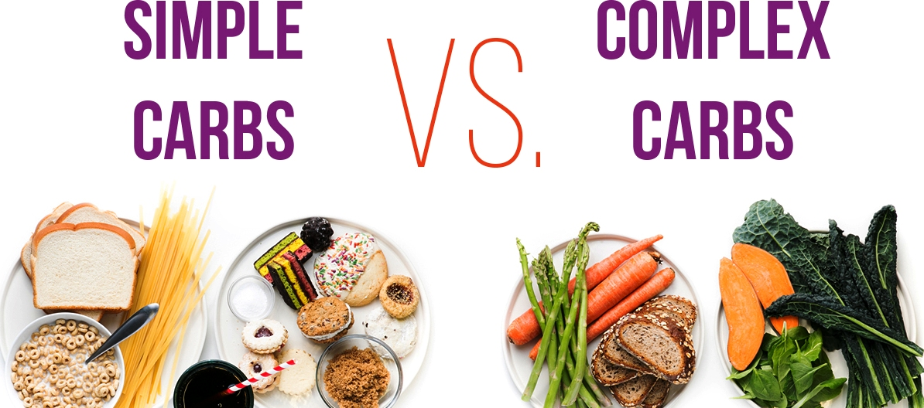
These break down into sugar and increase the blood sugar
Need for some energy

Slide 24
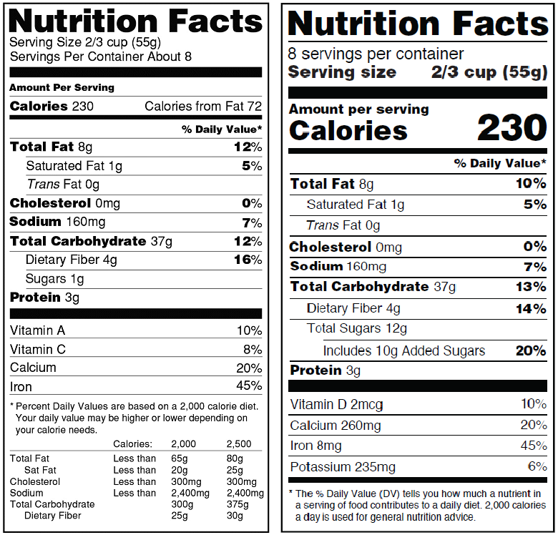
Carbohydrate
Counting
Total Carb
Fiber
Net Carb
Measurement cup or food scale
Total Carb 37
Fiber 4
Net Carb 33

Slide 25
Carbohydrate Servings
1 serving is about 15 carbs
THE HALF RULE
  About ½c of most carbohydrate foods or ½ piece of fruit
  EXCEPTIONS:
    1c Peas and Winter Squash
    1c Berries and Melons
    1 slice of most bread
    1 c milk
    1T of Jam, Honey, Sugar, Syrup

Slide 26
Carb guidelines +/- 5 grams
Breakfast | Snack | Lunch | Snack | Dinner | Snack
30 | 20 | 50 | 20 | 50 | 20-30

Slide 27
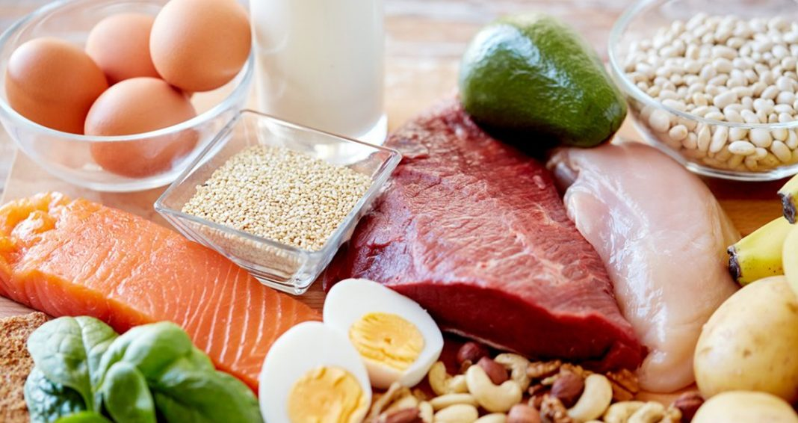
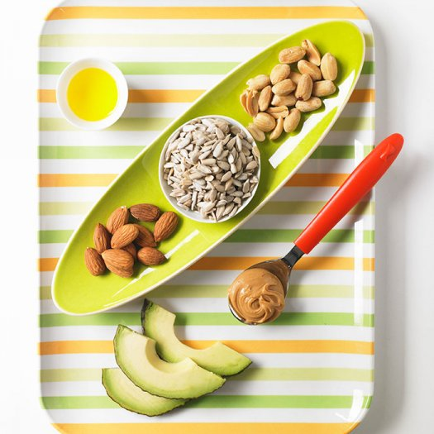

Non-Carb foods
Protein, Fats, and Non-starchy Vegetable
Protein: Helps you
feel fuller longer
Fats: Slows down
stomach emptying

Slide 28
Proteins
Poultry (Chicken, Turkey)
Beef
Pork
Fish and Shellfish
Game (Venison/Deer, buffalo, Elk, Duck, etc)
Cheese
Eggs (Fat in Yolk)
Tofu
Nuts and Nut Butter (High Fat)

Slide 29
Fats
Healthy (Monounsaturated)
  Avocado
  Olives
  Sesame Seeds
  Nuts
    Almond
    Cashew
    Peanuts
    Pecans
  Oil-
    Olive
    Peanut Oils

Slide 30
Fats (avoid if possible)
Polyunsaturated
  Nuts (Walnut)
  Seeds (Pumpkin, sunflower)
  Light Margarine
  Mayonnaise
  Miracle Whip
  Salad Dressing
Saturated and Trans
  Bacon
  Butter
  Coconut
  Cream
  Cream cheese
  Sour Cream
  Margarine

Slide 31
Vegetables
Most are considered FREE CARBS
EXCEPT:
  Potatoes (any variation backed, mashed, fries)
  sweet potatoes/yams
  leeks
  peas
  Corn
  Winter Squashes (Butternut, acorn)

Slide 32
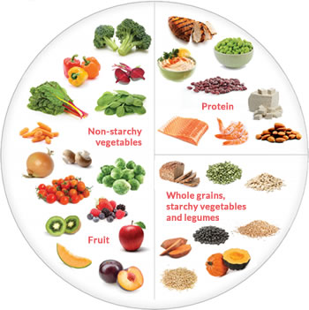

Slide 33
Free Drinks and food (5 carb or less)
Carbonated or mineral water
Club Soda
Sugar Free drink mixes, soft drinks
Coffee (only 1 c due to caffeine)
Tea
Condiments
  Ketchup (1T)
  Mustard
  Taco Sauce
  Vinegar
  Dill Pickles
  Soy Sauce
  Hot pepper sauce (Tabasco, Chalula, etc)
  Worcestershire Sauce
  Seasonings

Slide 34
Dietary Helps
Avoid sweets
  Sugar, corn syrup, fructose, honey, sucrose, glucose, molasses, dextrose
Avoid highly processed foods
  Rapid raise in blood sugar and high in bad fats
Eat small meals
Eat a small breakfast
  Avoid fruit, juice, milk, yogurt, and processed cereal/oatmeal
Eat free foods (celery, broccoli, cauliflower, lettuce, asparagus, tomatoes, etc)
Avoid low and non-fat foods (added sugars)
Avoid artificial sweeteners
  Aspartame effects not well understood.

Slide 35
Plate Method

Slide 36
Handy Help

Slide 37
Carb Choices

Slide 38
Self monitoring of blood Glucose
Let’s Practice!

Slide 39
Resources
https://www.cdc.gov/diabetes/managing/eat-well.html
http://www.lillydiabetes.com/_assets/pdf/ld90766_carbguide.pdf
https://www1.nichd.nih.gov/publications/pubs/Documents/managing_gestational_diabetes.pdf
Sweet Success Express
ACOG

